Slide 1
news for u wireframes & prototypes
Version 1.0 – agile alligators

Slide 2
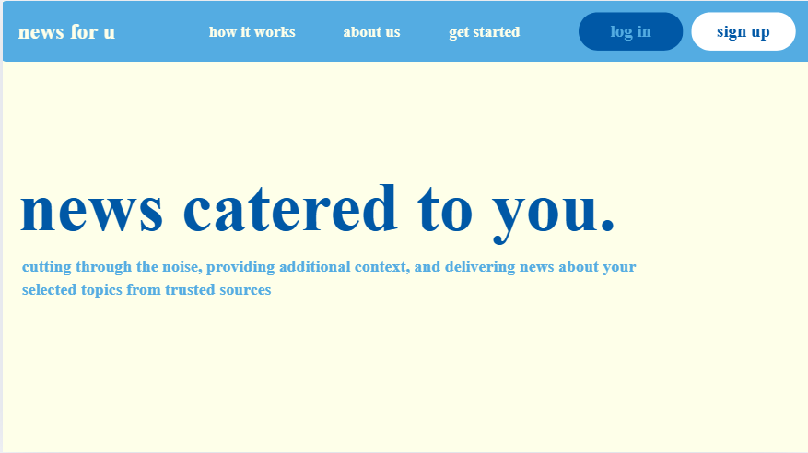
Flow Description:
Given the user is not logged in, When they land on the homepage, Then they can navigate via the top bar (About Us, How It Works, Log In, Sign Up).
Validation Focus: Navigation clarity & accessibility contrast.
Check that users can find “Get Started” within 5 seconds.
Confirm that clicking “Get Started” opens the sign-up pop-up (Slide 2).
Accessibility Test: Toggle “High Contrast” → background darkens, all text meets contrast ratio ≥ 4.5 : 1.
Edge Case:
If user presses “Get Started” twice rapidly, Then pop-up appears once (no duplicate overlay).

Slide 3
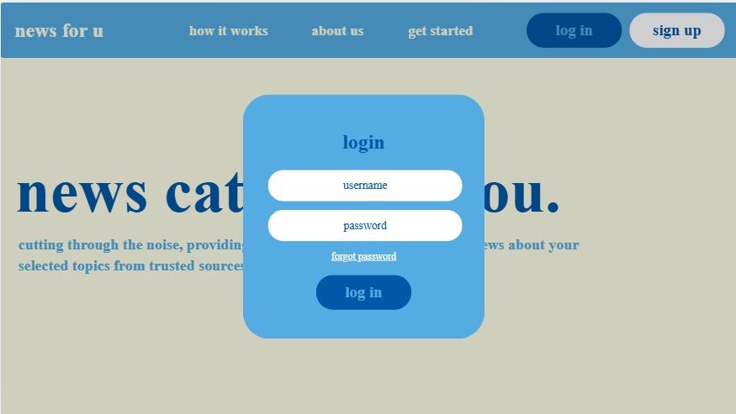
Log In / Sign Up Pop-Up (Main Pathway)
Flow Description:
Given the user clicks Log In, When they enter credentials and press “Submit,” Then the system validates and either authenticates or shows an error.
Validation Focus: Error visibility and recovery.
Intentionally test invalid credentials → red text “Email or password incorrect.”
Confirm the error text is high-contrast and appears within 0.5 s.
Accessibility: Screen reader announces “Login failed.”
Usability Goal: Verify users locate the “Forgot Password?” link after an error without hints.

Slide 4
Log In (Error Variant)
Flow Description:
Given invalid credentials are entered twice, When “Log In” is clicked, Then a red error banner appears and the “Forgot Password?” link becomes visually emphasized.
Validation Focus: Recovery comprehension.
Ask testers: “What would you do next?”
Measure how long it takes users to notice and use the recovery link.

Slide 5
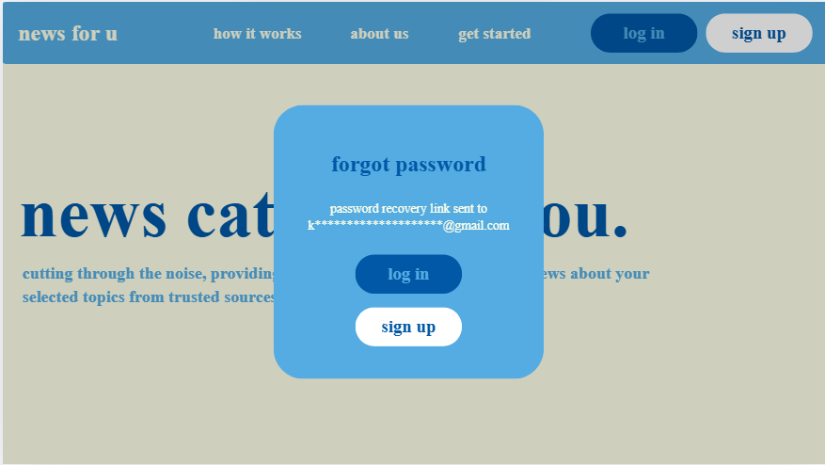
Forgot Password
Flow Description:
Given the user clicks “Forgot Password,” When they submit an email, Then the UI confirms “If an account exists, you’ll receive a reset link.”
Validation Focus: Neutral feedback and reassurance.
Prevents disclosure of whether an email exists.
Ensure confirmation appears within 2 s.
Accessibility Goal: Confirmation text read aloud by screen reader.

Slide 6
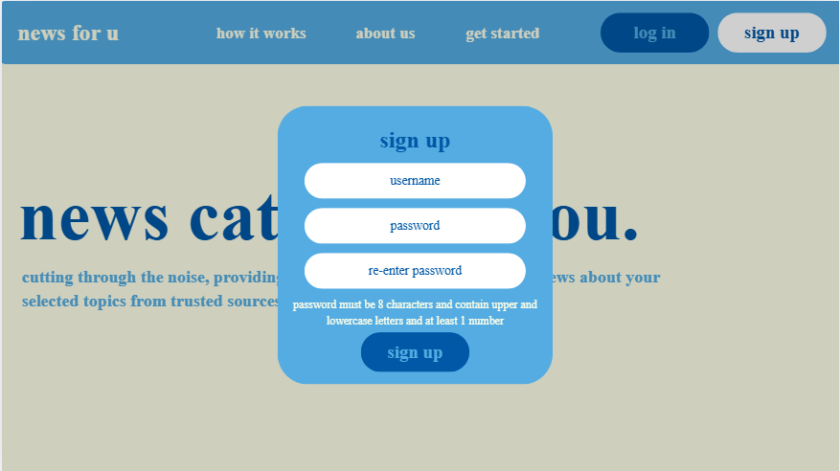
Sign Up (Password Constraints)
Flow Description:
Given a new user opens “Sign Up,” When they enter a password, Then visual indicators show which constraints (8+ chars, upper/lowercase, number) are unmet.
Validation Focus: Progressive error reduction & disabled button logic.
“Sign Up” button remains disabled until all constraints satisfied.
Red text disappears dynamically as constraints are met.
Ask testers if they understand the rule feedback without reading full text.

Slide 7
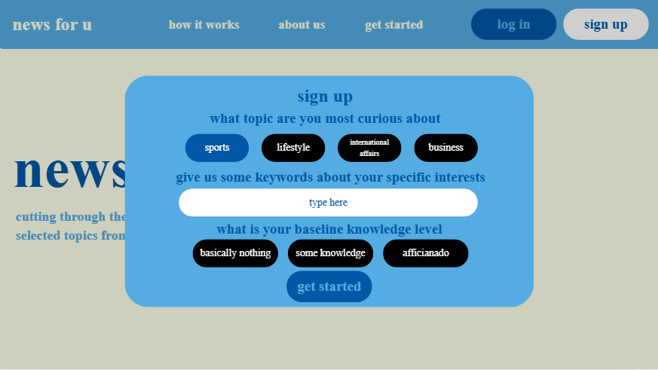
Sign Up – Interest Collection
Flow Description:
Given password creation succeeded, When user selects interests, Then each selected topic highlights in blue (max 5 selections).
Validation Focus: Interaction clarity and error prevention.
Attempt 6th selection → show toast: “You can select up to 5 topics.”
Accessibility: Keyboard users can tab through interest list.
Usability Goal: Ensure users grasp how to finalize with “Get Started.”

Slide 8
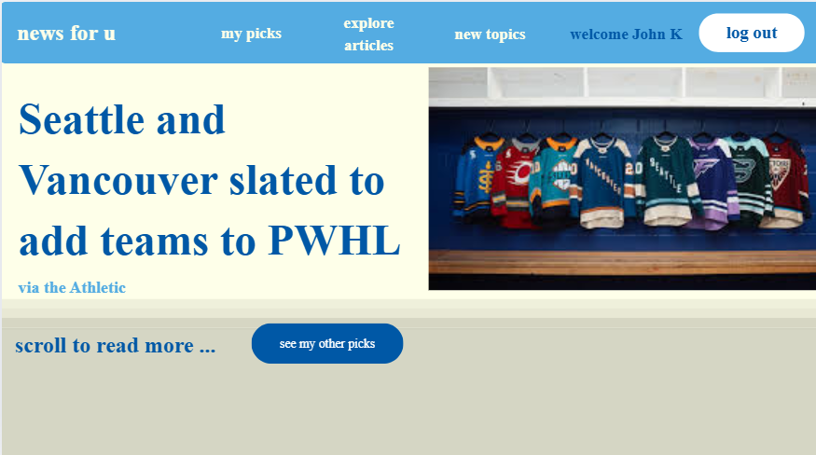
Home Screen (Logged In)
Flow Description:
Given the user is logged in, When the homepage loads, Then the top article (based on recency & interests) is displayed with a “Read More” option.
Validation Focus: Personalization transparency & discoverability.
Ask testers: “Do you understand why this article is shown?”
“See My Picks” → navigates to list view.
Edge Cases:
If no articles available → placeholder “No articles yet. Try adding new topics.”
If slow network → show loading skeleton for ≤ 2 s (meets Performance NFR-1).
Accessibility Goal: Verify all interactive elements are focusable via keyboard.

Slide 9
Explore Articles / Add Topic
Flow Description:
Given a user is browsing, When they type into search or add topic, Then results appear dynamically.
Validation Focus: Empty-state & error handling.
No results → “Nothing found for ‘query’ — try another term.”
Blank field disables “Add Topic” button.
Usability Goal: Confirm users can recover from an empty search without confusion.

Slide 10
High-Risk Concept Flow Prototype: AI Reading Level Toggle
Scenario Title: Switch Between Reading Levels (Beginner / Intermediate / Expert)
Flow Description:
Given the user is reading an article at “Beginner” level,
When they select “Intermediate” or “Expert,”
Then the system regenerates the article summary via AI within 2 seconds, showing a spinner/loading state until complete.
Validation Focus:
Do users understand that different levels mean different depth, not different topics?
Can users tolerate a short delay while AI regenerates text?
Does the spinner or placeholder communicate progress clearly?
Edge Cases:
AI fails → fallback: “Couldn’t load expert version—try again.”
Accessibility: Screen reader announces “Loading expert version.”

Slide 11
High-Risk Concept Flow Prototype: Tooltip Definitions (Highlight & Explain Terms)
Scenario Title: View Definitions of Technical Terms
Flow Description:
Given an article displays highlighted terms (e.g., “fiscal policy”),
When the user hovers or taps on the word,
Then a small tooltip shows a concise definition, closing automatically when focus moves away.
Validation Focus:
Can users trigger and close tooltips easily on both desktop and mobile?
Is the definition concise and readable (≤ 20 words)?
Do popups avoid covering surrounding text?
Edge Cases:
Tooltip overlaps adjacent words → reposition automatically.
Keyboard users can tab through highlights.
Accessibility Goal: Tooltip meets contrast ≥ 4.5:1, screen reader reads term + definition.

Slide 12
High-Risk Concept Flow Prototype: Recommendations & Feedback
Scenario Title: Give Feedback on Recommended Articles
Flow Description:
Given a user finishes reading an article,
When the system shows 3–5 recommended articles,
Then the user can mark each as “Useful 👍” or “Not Useful 👎.”
Validation Focus:
Do users recognize that feedback affects future recommendations?
Is it clear that marking “Not Useful” removes the article immediately?
Can users undo or change feedback easily?
Edge Cases:
Previously read articles do not reappear (meets functional story “Avoid Duplicate Recommendations”).
Tooltip confirms feedback: “Thanks! We’ll adjust your feed.”
Performance Check: Interaction response ≤ 0.5 s after click.

Slide 13
High-Risk Concept Flow Prototype: Topic Subscription & Breaking News Alerts
Scenario Title: Give Feedback on Recommended Articles
Flow Description:
Given a user finishes reading an article,
When the system shows 3–5 recommended articles,
Then the user can mark each as “Useful 👍” or “Not Useful 👎.”
Validation Focus:
Do users recognize that feedback affects future recommendations?
Is it clear that marking “Not Useful” removes the article immediately?
Can users undo or change feedback easily?
Edge Cases:
Previously read articles do not reappear (meets functional story “Avoid Duplicate Recommendations”).
Tooltip confirms feedback: “Thanks! We’ll adjust your feed.”
Performance Check: Interaction response ≤ 0.5 s after click.

Slide 14
High-Risk Concept Flow Prototype: Feedback on AI Clarity
Scenario Title: Rate AI-Simplified Text (Yes/No Clarity Feedback)
Flow Description:
Given a simplified article is displayed,
When the user selects “Was this clear? → Yes / No,”
Then the response is logged with timestamp and confirmation: “Thanks for your feedback!”
Validation Focus:
Can users give feedback without interrupting reading flow?
Is confirmation subtle yet noticeable?
Do users understand that feedback improves future tailoring?
Edge Cases:
Multiple clicks only register once.
“No” feedback triggers suggestion: “Try Intermediate Level.”

